Slide 1

Welcome to Entre Estrellas Café y Souvenirs
Where good coffee meets the magic of the stars.

Slide 2

Scene 1 – The incident at the counter

Slide 3
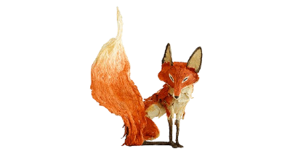
Scene 2 – The system review

Slide 4
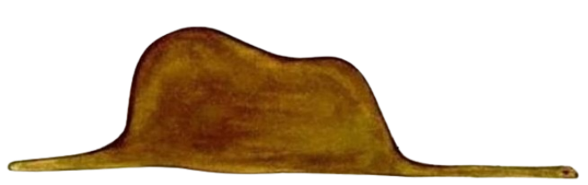
Scene 3 – Testing the fix

Slide 5
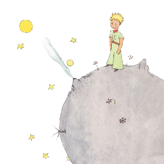
Scene 4 – Final words

Slide 6
Thank You for Your Attention!
It is only with the heart that one can see rightly...

